Slide 1
Cybersecurity
Firewalls

Slide 2
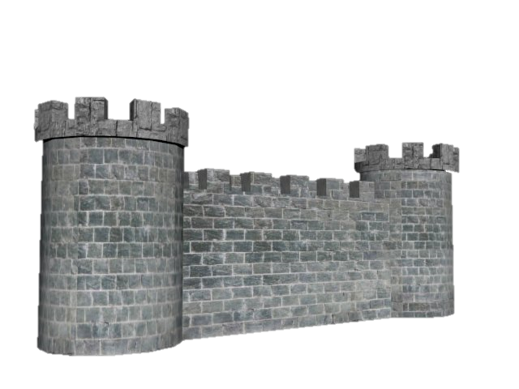
Common fire line of defense
Firewalls are everywhere
Home, office, your operating system
Gatekeeper
Everything passes through the firewall
Corporate control
Data inbound and outbound
Control of inappropriate content
School web filters, offensive content
Protection from evil-doers
Anti-virus, anti-malware

Slide 3
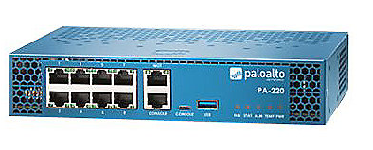
Network-based Firewalls
Typically Layer 3 devices (routers)
“You can pass.”, “You cannot.”
Usually acts as gateway for network
Filters traffic based on port number
OSI Layer 4 (TCP/UDP)
Some can filter up through OSI Layer 7
Encrypt traffic coming and going
Protect traffic between locations
Proxy traffic

Slide 4



Stateless Firewall
Does not track traffic flow
Each packet examined, regardless of previous packets
Traffic sent outside active session will pass stateless firewall
DAVID
192.168.0.101
FIREWALL
SERVER
192.168.100.1
Rule # | Src IP | Dest IP | Dest Proto | Dest Port | Action
1 | 192.168.0.101 | 192.168.100.1 | tcp | 80 | allow
2 | 192.168.100.1 | 192.168.0.101 | tcp | any | allow

Slide 5
Stateful Firewall
Remember the state of each session
Everything considered as a valid flow is allowed
DAVID
192.168.0.101
FIREWALL
SERVER
192.168.100.1
Rule # | Src IP | Dest IP | Dest Proto | Dest Port | Action
1 | 192.168.0.101 | 192.168.100.1 | tcp | 80 | allow
Session | Proto | Src IP | Src Port | Dest IP | Dest Port
1 | tcp | 192.168.0.101 | 15442 | 192.168.100.1 | 80

Slide 6
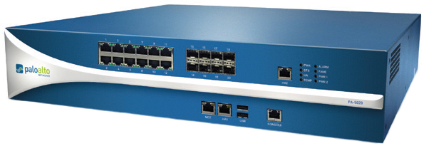
Application-Aware Security Devices
OSI Layer 7 device (Application)
Also known as
Application layer gateway
Stateful multilayer inspection
Deep packet inspection
Requires advanced decodes
Each packet analyzed and categorized before deciding

Slide 7
Application-Aware Security Devices
Network-based Firewall
Control traffic flows based on application
MySQL server, IIS, YouTube
Intrusion Prevention Systems
Identify application
Watch for application-specific vulnerability signatures in traffic
Host-based firewalls
Determines which applications are allowed to pass or not

Slide 8
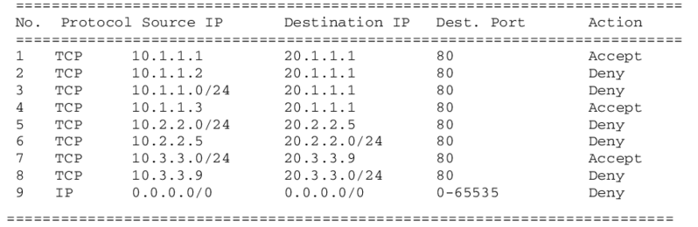
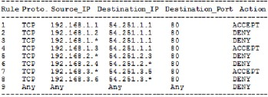
Firewall Rules
Access Control Lists (ACL)
allow or deny traffic based on rules (aka metrics)
Groupings of categories
Source/Destination IP, port, time of day, application
A logical path
Usually top-to-bottom
Rules vary
Broad and general or very, very specific
Specific rules usually at the top of list
Implicit Deny
Most firewalls include a deny at the bottom
“Unless I said to allow it, deny it” (safety)

Slide 9
Webserver Firewall Ruleset
Rule Number | Remote IP | Remote Port | Local Port | Protocol | Action
1 | All | Any | 22 | TCP | Allow
2 | All | Any | 80 | TCP | Allow
3 | All | Any | 443 | TCP | Allow
4 | All | 53 | Any | UDP | Allow
5 | All | 123 | Any | UDP | Allow
6 | All |  |  | ICMP | Deny

